Slide 1
The Normality, Persistence and Pervasiveness of Share Market Declines
April 2025

Slide 2
Overview
Long-term investors experience the real prevalence and normality of negative returns, including market corrections (represented by a > -10% decline) and bear markets (-20% declines) over their investment horizons.
Australian Share Market: Analysis since 1994 shows negative returns in 10 out of 31 years (33%) and intra-year declines of -10% or worse in 24 out of 31 years (75%). Despite this, the average annual return was +8.63%.
US Share Market: Analysis: Analysis since 1980 reveals negative returns in 11 out of 45 years (24%) and intra-year declines of -10% or worse in 26 out of 45 years (60%). The average annual return was +10.90%.
UK Share Market: Analysis since 1986 shows negative returns in 12 out of 39 years (31%) and intra-year declines in 26 out of 39 years (67%). The average annual return was +9.77%.
Bear Markets: There have been 12 bear markets in global equity markets since 1970, with an average decline of -31% and lasting an average of 11 months before recovery.
In conclusion, maintaining a rational and disciplined approach during market turbulence is crucial for long-term investment success, as poor returns are more often due to investor behaviour rather than underlying market performance.

Slide 3
The Normality, Persistence and Pervasiveness of Share Market Declines
The disruption in the rules based global order (which includes the latest Trump tariff proposals) has been deeply unsettling for consumers, businesses and investors. Global financial markets have recoiled at the speed and severity of change, and it will take some time for market participants to grasp the ramifications over the remainder of the second Trump presidency and beyond.
With the turmoil in global share markets, it is a timely reminder for long-term investors of the normality and very real prevalence of negative returns, including market corrections (represented by a > -10% decline) and bear markets (-20% declines) in long-term returns data.
While the instinctive response to a perceived threat or danger of our sympathetic nervous system is fight or flight, it is helpful to give context to the prevalence of such events to ensure a sound and rational approach is applied to the forward period and importantly to assist us in quantifying the significance of the presumed hazard. Research continues to highlight that poor investment returns are more often attributed to poor investor behavior than the underlying return of investment markets.
To emphasize the relative global pervasiveness of the global equity markets, here are some observations from the Australian, US and UK.

Slide 4
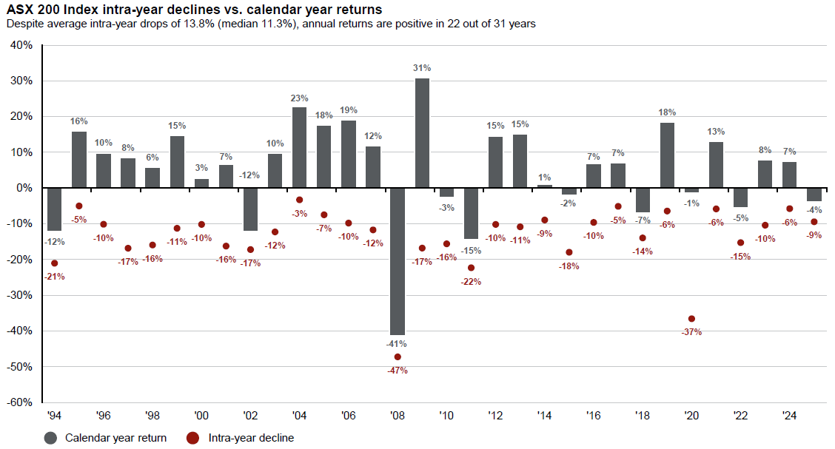
S&P|ASX All Ordinaries Index (Total Return) | January 1994 – December 2024
Of the Australian share market calendar year returns over the last 31 years, we can observe:
Returns were negative approximately 10 out of 31 years – 33% of the time.
Returns of -10% or worse, also known as ‘intra-year declines,’ occurred in 24 of 31 years – an astonishing 75% of the time.
The average annual return was +8.63% per annum, despite the average intra-year decline being -13.8%.
Grey bars =
calendar year total returns
Red dots =
intra year worst % decline

Slide 5
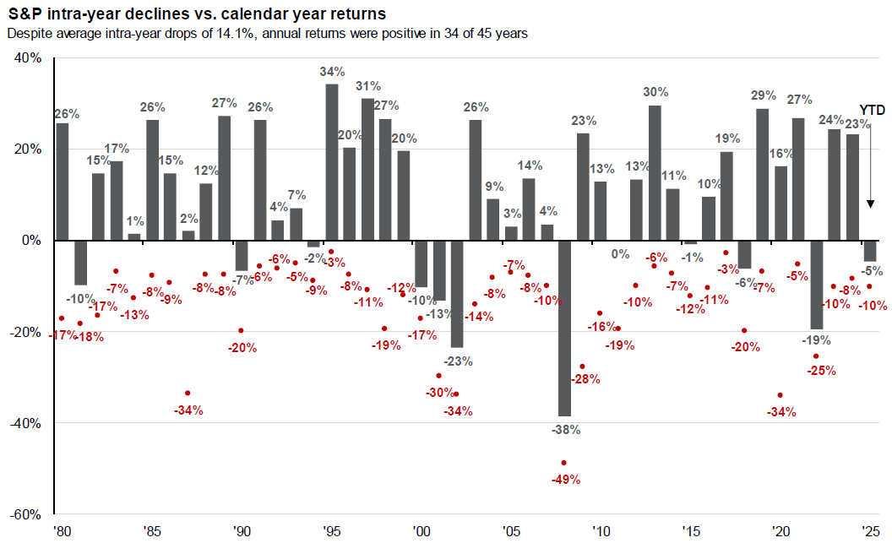
US S&P 500 Index (Total Return) | January 1980 – December 2024
Of the US share market calendar year returns over the last 45 years, we can observe:
Returns were negative approximately 11 out of 45 years – 24% of the time.
Returns of -10% or worse, also known as ‘intra-year declines,’ occurred in 26 of 45 years – 60% of the time.
The average annual return was +10.90%, despite the average intra-year decline being -14.1%.
Grey bars =
calendar year total returns
Red dots =
intra year worst % decline

Slide 6
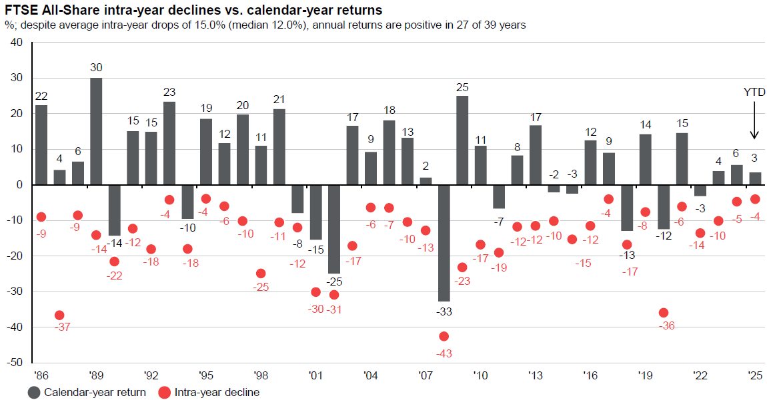
UK FTSE All-Share Index (Total Return) | January 1986 – December 2024
Of the UK share market calendar year returns over the last 39 years, we can observe:
Returns were negative approximately 12 out of 39 years – 31% of the time.
Returns of -10% or worse, also known as ‘intra-year declines,’ occurred in 26 out of 39 years – 67% of the time.
The average annual return was +9.77%, despite the average intra-year decline being -15.5%.
Grey bars =
calendar year total returns
Red dots =
intra year worst % decline

Slide 7
Other Key Insights
The following charts reflect the incidence of more significant declines in global shares, represented by the term – ‘bear market’, which equates to a decline of > negative -20%, since 1970.
Of note;
There have been 12 bear markets in global equity markets since 1970.
On average, bear markets have declined by -31% from their previous peak to trough.
On average, bear markets have lasted 11 months, before prices recovered to their previous levels but importantly in many instances the recovery period has been shorter, catching out those who have attempted to time the random nature of financial market gyrations.

Slide 8
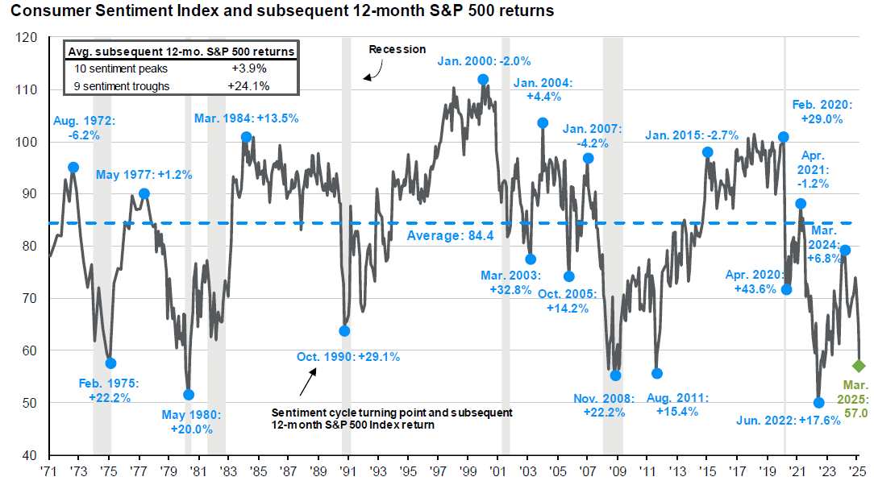
Consumer Sentiment Index + subsequent 1 Year US Sharemarket Returns
Grey Line =
the University of Michigan Sentiment Index (surveying 500 consumers monthly for their views on the economy, spending, savings…)
Blue Dot & % Return = the return of the US Sharemarket 12 months from the point on the Sentiment Index
Key Observation
- Significant positive sharemarket returns often follow the lowest point of consumer sentiment

Slide 9
APW Partners
Gregory P Keady: gkeady@apwpartners.com.au, Tel: 0439 041 199
Jeff Wain: jwain@apwpartners.com.au, Tel: 0400 328 530
Alistair Bett: abett@apwpartners.com.au, Tel: 0411 205 350
Calvin Nee: cnee@apwpartners.com.au, Tel: 0414 659 402

